Slide 1

Home renting WEB application
VIKAS MOURYA –-TYCS---528

Slide 2
Introduction
A majority of unpleasant issues faced by landlords and tenants seem to grow due to lack of communication. Late rent payments turns into an eviction. A non-functional AC or a broken window becomes a reason to break a lease. Fortunately, building a positive relationship doesn't take much effort and it all starts with one basic idea: communication. Rental Property Site provides the solution by offering the ability to share issues between tenants and landlords which leads to rapid issue resolution and fewer misunderstanding. The goal of the Web app is to create a better relationship between tenants and landlord. The Rental Property Management WEB app is designed to support both tenants and landlords by enabling them to document and communicate repair issues, send automatic rent reminders, package notifications and emergency information. It helps the tenant with making Payments and it also helps the Landlord to keep track of issues posted by tenants. Effectively resolving the apartment issues is important to the tenant's longterm future and the Rental Property Site will be an important tool for creating rental housing stability by helping tenants speak with greater credibility through initiating and documenting communications and building productive relationships with landlords.

Slide 3
System Use
Software Requirements
Frontend
React.js (Library by Facebook )
mongoDB / firebase by Google
Backend
Express.js
Node.js
Hardware Requirements
4GB Ram
25GB Rom
Processor i3 intel case /Ryzen
Operating system (linux,Windows,MAC)

Slide 4
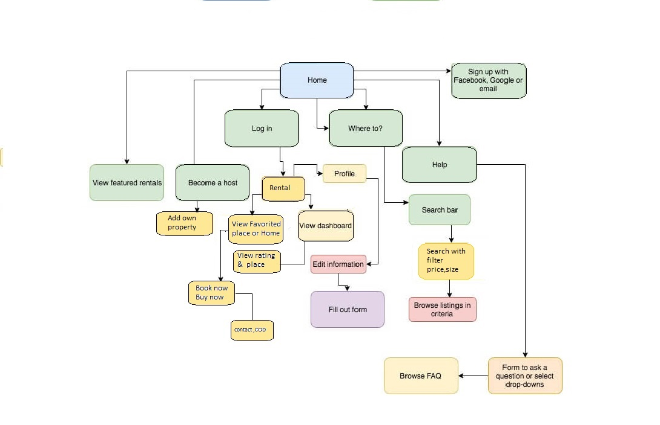
Block Diagram
Block Diagram

Slide 5
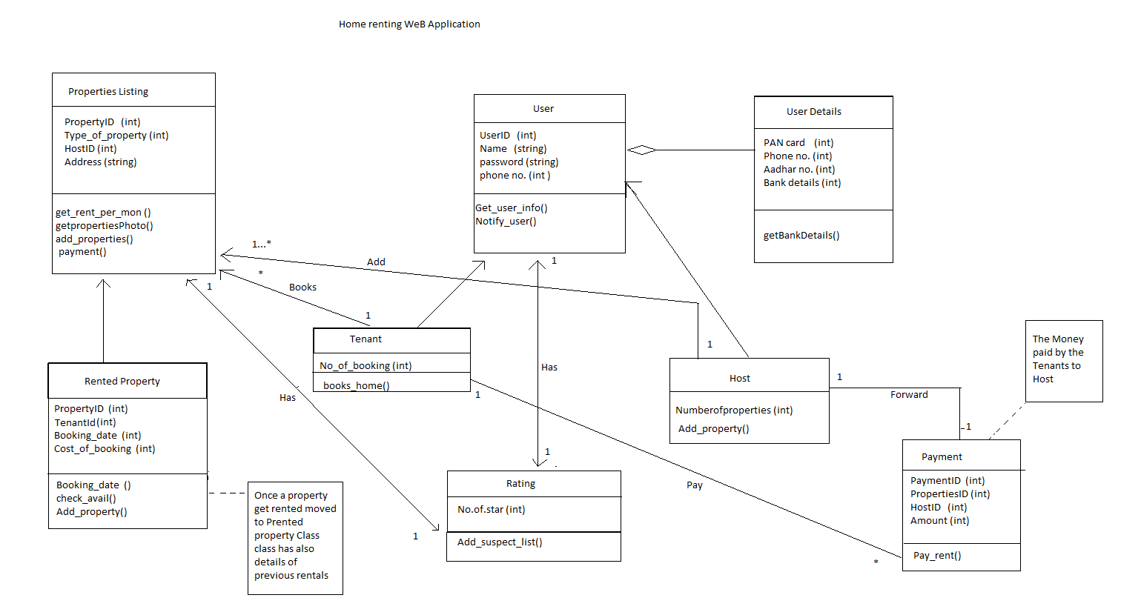
Class diagram

Slide 6
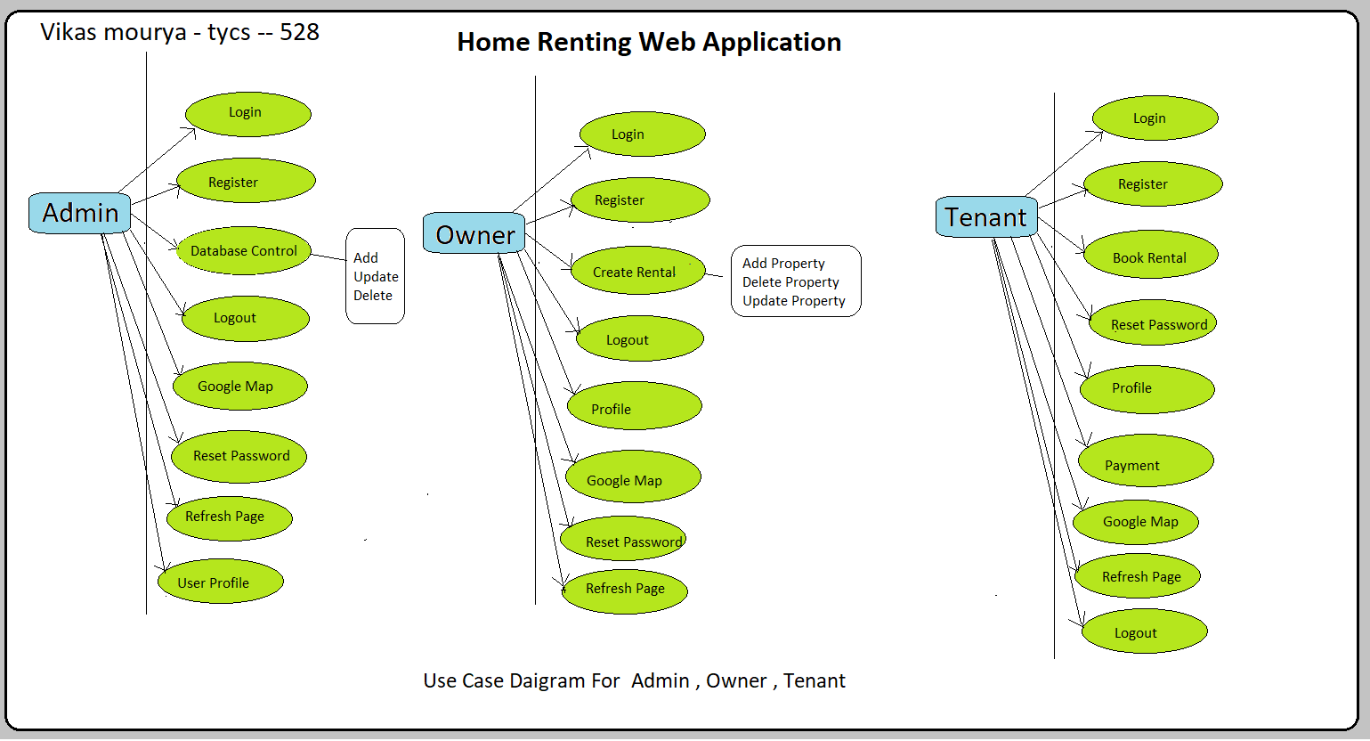
Class diagram

Slide 7
Admin Use Case Diagram
It shows what types of process in the system are done by an admin. Here, admins can log in to the system after registration. Admin can control the database like delete something or update something from the database. Also, they can see the Google map and, they can easily contact others. Admin also reset the password and refresh the page.
Owner Use Case Diagram
It shows what types of processes in the system are done by an owner. Here, owner can register in the system and log into the system. Also, could add or delete the Rental of his/her house.
Tenant Use Case Diagram
It shows what types of processes are done by a tenant. Here, tenants can log in to the system after their registration. Tenants can set their own profile and reset the password. Also, contact with others using a contact Details and refresh the page.

Slide 8
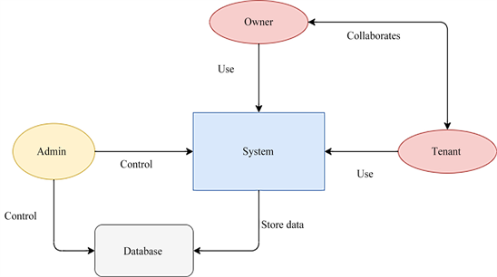
Activity Diagram

Slide 9
